Slide 1
Entrepreneurship
THE MARKETING PLAN
Rameen Arshad

Slide 2
Objectives
Understand the factors that influence customers to adopt a new product or service offered by a venture
Gain familiarity with a process for defining a venture's core customers
Article: Growing Ventures Can Anticipate Marketing Stages
Case Study: Zipcar

Slide 3
Industry Analysis
It provides sufficient knowledge of the environment that can affect marketing strategy decision making.
Information can be gathered through secondary sources and market research.
  (customer needs, price, promotion, distribution, market position, market goals and objectives, how to meet those goals and objectives)
The entrepreneur can begin to understand competitors’ strengths and weaknesses; provides insight into how to position products or services

Slide 4
Industry Analysis (cont.)
Competitor Analysis
  Document current strategies of primary competitors.
  Information can be utilized to formulate the market positioning strategy.
  This analysis provides a solid basis for marketing decision making.

Slide 5
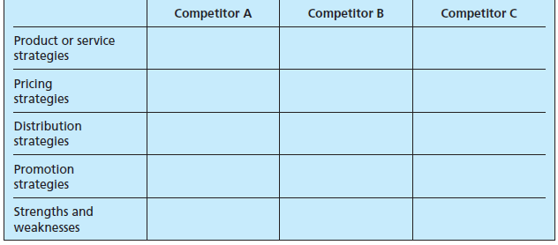
Industry Analysis (cont.)
Class activity.
  Think of a product, Imagine your competitors, fill the table.

Slide 6
Marketing Research for the New Venture
Step One: Defining the Purpose or Objectives
  Make a list of the information that will be needed to prepare the marketing plan.
Possible questions can be:
How much would potential customers be willing to pay for the product or service?
Where would potential customers prefer to purchase the product or service?
Where would the customer expect to hear about or learn about such a product or service?

Slide 7
Marketing Research for the New Venture (cont.)
Step Two: Gathering Data from Secondary Sources
  Secondary sources can include trade magazines, newspaper articles, libraries, government agencies, the Internet, and commercial data.
Step Three: Gathering Information from Primary Sources
  Data collection procedures - Observation, networking, interviewing, focus groups, and experimentation.
  Data collection instrument - Questionnaire.

Slide 8
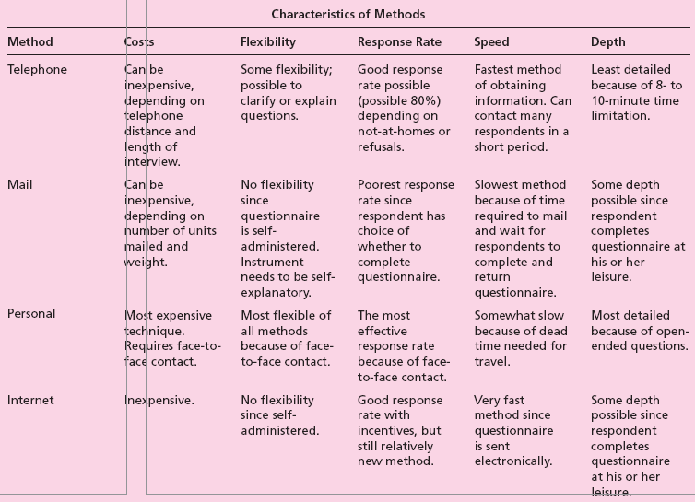
Table 8.3 A Comparison of Survey Methods

Slide 9
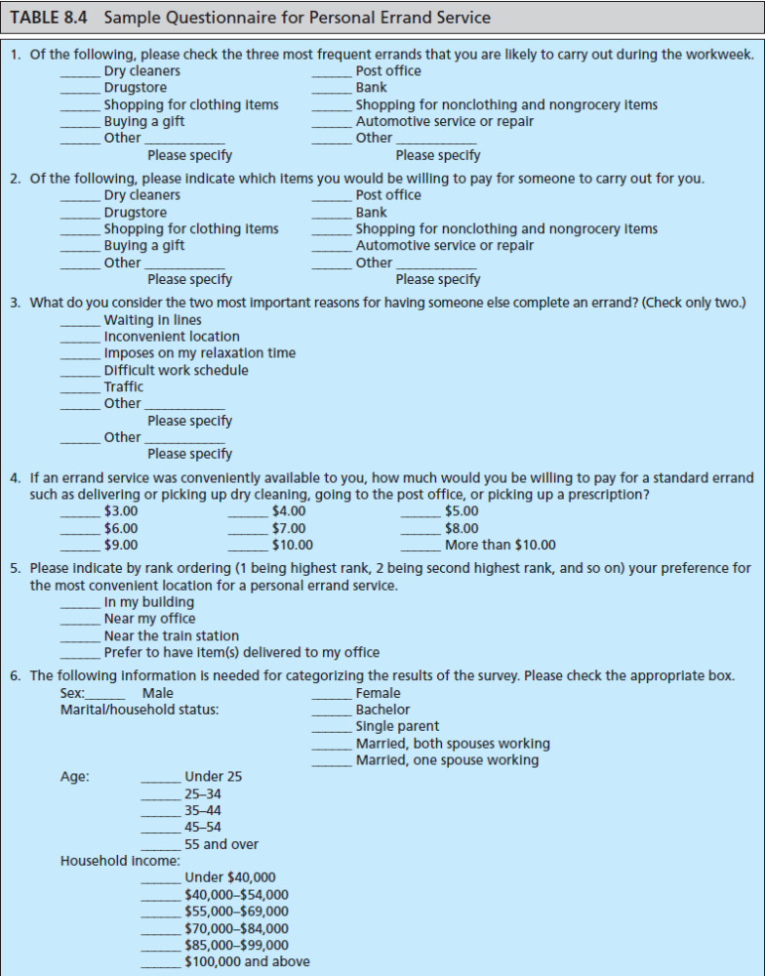

Slide 10
Marketing Research for the New Venture (cont.)
Step Four: Analyzing and Interpreting the Results
  Results can be tabulated by hand or on a computer.
  Evaluated and interpreted should be based on research objectives.
  Cross-tabulated data can provide more focused results.

Slide 11
Marketing Research Class activity.
Imagine you are starting your own venture.
  Select your product, start research for your marketing plan
  Make a list of 5 areas of information/questions/objectives that you think are important to answer (All possible questions)
  List all possible sources where you can get
    secondary information (A quick google search may help to start)
    Primary Information (Decide what is the best option for your product and why?)
  Design your own questionnaire based on your requirements/objectives/questions (at least 5 questions).
    What are the possible objectives of the entrepreneur who designed Table 8.4

Slide 12
Understanding the Marketing Plan
Marketing plan - A written statement of marketing objectives, strategies, and activities to be followed in business plan.
It is designed to provide answers to three basic questions:
  Where have we been?
  Where do we want to go (in the short term)?
  How do we get there?

Slide 13
Characteristics of a Marketing Plan
A marketing plan should:
  Provide a strategy.
  Be based on facts/assumptions.
  Describe an organization for implementation.
  Provide for short-term and long-term continuity.
  Be simple and short.
  Be flexible.
  Specify criteria for control.

Slide 14
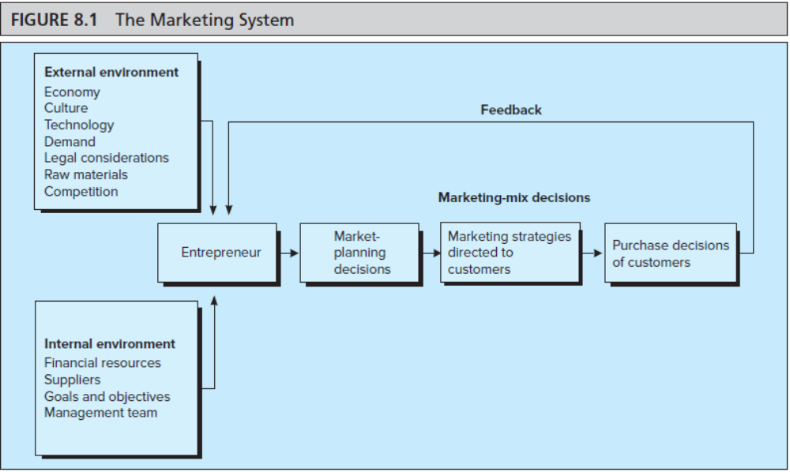
Figure 8.1- The Marketing System
The major interacting components, internal & external, that enable the firm to successfully provide products/services to the marketplace

Slide 15
The Marketing Mix
A combination of product, price, promotion, and distribution and other marketing activities needed to meet marketing objectives.
Variable | Critical Decisions
Product | Quality of components or materials, style, features, options, brand name, packaging, sizes, service availability, and warranties.
Price | Quality image, price, quantity, discounts, allowances for quick payment, credit terms, and payment period.
Channels of distribution | Use of wholesalers and/or retailers, type of wholesalers or retailers, how many, geographic coverage, inventory, and transportation.
Promotion | Media alternatives, message, media budget, role of personal selling, sales promotion (displays, coupons, etc.), and media interest in publicity.

Slide 16
How to organize your market plan.
Your Market plan shall Answer the following 3 Questions:
Where have we been?
Where do we want to go (in the short term)?
How do we get there?

Slide 17
Steps in Preparing the Marketing Plan
Defining the Business Situation
  Situation analysis - Describes past and present business achievements of new venture.

Slide 18
Steps in Preparing the Marketing Plan
Where have we been?
For new venture, provide information on:
  how and why the product/service was developed (to satisfy consumer needs).
For venture that has already started up, provide information on:
  Present market conditions.
  Performance of the company’s goods and services.
  Future opportunities or prospects.

Slide 19
Steps in Preparing the Marketing Plan (cont.)
Defining the Target Market/Opportunities and Threats
  Your target Market
  The target market is specific group of potential customers toward which the venture aims its marketing plan.
Market segmentation - Dividing a market into definable and measurable groups for purposes of targeting marketing strategy.

Slide 20
Steps in Preparing the Marketing Plan (cont.)
Establishing Goals and Objectives
  These are statements of level of performance desired by new venture.
  Realistic and specific marketing goals and objectives respond to the question: “Where do we want to go?”.
  Limit the number of goals or objectives to between six and eight.
  Goals should represent key areas to ensure marketing success.

Slide 21
Steps in Preparing the Marketing Plan (cont.)
Defining Marketing Strategy and Action Programs
  Product or service
    May consider more than the physical characteristics.
    Involves packaging, brand name, price, warranty, image, service, delivery time, features, style, and even the Web site.
  Pricing
    Costs - Material costs, labor costs, cost of goods from suppliers, labor and overhead expenses, etc.
    Margins or markups - Expected to cover overhead costs and some profit.
    Competition.

Slide 22
Steps in Preparing the Marketing Plan (cont.)
  Distribution
    Provides utility to the consumer.
    Must also be consistent with other marketing mix variables.
  Promotion
    To inform potential consumers about the product’s availability or to educate the consumer.
    Methods include print, radio, or television advertising, Internet, direct mail, magazines, or newspapers.
    The entrepreneur should considering both costs and effectiveness of the medium in meeting the market objectives.

Slide 23
Steps in Preparing the Marketing Plan (cont.)
Marketing Strategy: Consumer versus Business-to-Business Markets
  Business-to-business markets involves selling of products or services to another business.
    Usually aims at selling a large volume in one transaction.
    Involves a more direct channel of distribution.
    Use magazine advertising, direct sales, and trade shows.
  Consumer markets involve sales to households for personal consumption.

Slide 24
Steps in Preparing the Marketing Plan (cont.)
Budgeting and Implementation
  Budgeting
    Costs should be reasonably clear.
    Assumptions, if necessary, should be clearly stated.
    Useful in preparing the financial plan.
  Implementation
    The plan is meant to be a commitment by the entrepreneur to a specific strategy.
    Entrepreneur should ensure coordination and implementation of the plan.

Slide 25
Steps in Preparing the Marketing Plan (cont.)
Monitoring the Progress of Marketing Actions
  Involves tracking results of the marketing effort.
  Entrepreneur should prepare for contingencies.
  Minor adjustments in the plan are normal; significant changes indicate a poorly prepared plan.
  Weaknesses in market planning may be due to:
    Poor analysis of the market and competitive strategy.
    Unrealistic goals and objectives.
    Poor implementation of the outlined plan actions.
    Unforeseen hazards like weather or war.

Slide 26
Class Activity 3.1
Process of segmenting and targeting customers:
Decide on general market or industry to pursue.
Divide market into smaller groups based on:
Characteristics of the customer
  Geographic (state, country, city, region)
  Demographic (age, gender, occupation, education, income, and race)
  Psychographic (personality, lifestyle, beliefs, values, attitudes, interests)
Buying situation
  Desired benefits (Product features)
  Usage (rate of use of product)
  buying conditions (when, where, why)
  Awareness of buying intention (product familiarity, willingness to buy)
Select segment or segments to target
Decide strengths and weaknesses in the target market
Decide your, price, distribution, and promotion strategies.

